Slide 1

AN INTELLIGENT FRAMEWORK FOR IDENTIFYING THE COOKING STATE OF RICE
by
RUHINAAZ Y
Roll No. 224G1A0587
SIRI R
Roll No. 224G1A05A1
JANARDHAN P
Roll No. 234G5A0503
Under the guidance of
Dr P VEERA PRAKASH, M.Tech., Ph.D.
Assistant Professor
Department of Computer Science and Engineering (AI&ML)
Srinivasa Ramanujan Institute of Technology
Autonomous
Rotarypuram Village, B K Samudram Mandal, Ananthapuramu – 515701.
2025-2026

Slide 2

Contents
An Intelligent Framework for Identifing the Cooking State of Rice
Title Justification
Abstract
Problem statement
Objectives of Project
Literature survey for objectives
Proposed Work -(Methods to be followed for proposed system)
References
GitHub Link
Queries
B-03 | Department of Computer Science and Engineering | Srinivasa Ramanujan Institute of Technology | 2

Slide 3
Title Justification
An Intelligent Framework for Identifing the Cooking State of Rice
The project “An Intelligent Framework for Identifying the Cooking State of Rice” is essential for improving accuracy and efficiency in monitoring rice cooking stages. Traditionally, determining whether rice is raw, semi-cooked, or fully cooked relies on manual visual inspection, which is subjective, inconsistent, and prone to human error. In large-scale kitchens, food processing units, and automated cooking systems, such manual methods cannot guarantee uniform quality.
By applying deep learning and computer vision, this project enables an automated, reliable, and real-time classification of rice cooking stages using simple RGB images. This ensures consistent food quality, reduces waste due to overcooking or undercooking, and supports the development of smart kitchen automation technologies. The title reflects the core aim of constructing an intelligent system capable of accurately identifying cooking stages and enhancing the overall efficiency of the cooking process.
B-03 | Department of Computer Science and Engineering | Srinivasa Ramanujan Institute of Technology | 3

Slide 4
Abstract
An Intelligent Framework for Identifing the Cooking State of Rice
The increasing demand for consistent food quality and kitchen automation has created need for reliable methods to determine rice cooking stages. Traditional manual inspection is often subjective and inaccurate, resulting in inconsistent cooking outcomes.
This research aims to develop an intelligent system that classifies rice images into three categories: Raw, Semi-cooked, and Fully cooked. The goal is to automate the cooking stage identification process using a rice image data set.
The system utilizes deep learning techniques, applying transfer learning with pre-trained CNN models such as MobileNetV2 or ResNet50. The methodology includes image acquisition, preprocessing, feature extraction and classification using a fine-tuned neural network.
Although still under development, the system is expected to offer a scalable, efficient, and non-intrusive solution for real-time food assessment. The outcomes aim to support smart kitchen technologies, reduce human error and ensure quality.
B-03 | Department of Computer Science and Engineering | Srinivasa Ramanujan Institute of Technology | 4

Slide 5
Problem Statement
An Intelligent Framework for Identifing the Cooking State of Rice
Manual identification of rice cooking stages is subjective and inconsistent, as it depends heavily on a person’s experience, perception, and environmental conditions.
Large-scale or automated cooking environments cannot rely on human inspection, leading to inefficiency, delays, and frequent errors in determining whether rice is raw, semi-cooked, or fully cooked.
There is no automated, accurate, and real-time system capable of classifying rice cooking stages from images, resulting in quality variations and difficulty in maintaining uniform cooking standards.
B-03 | Department of Computer Science and Engineering | Srinivasa Ramanujan Institute of Technology | 5

Slide 6
Objectives of Project
An Intelligent Framework for Identifing the Cooking State of Rice
Research Objective 1:
To develop a deep learning–based model that accurately classifies rice images into raw, semi-cooked, and fully cooked stages using transfer learning techniques.
Research Objective 2:
To design an efficient image-processing workflow that enhances visual features and improves the reliability of cooking-stage prediction in real-time food assessment systems.
B-03 | Department of Computer Science and Engineering | Srinivasa Ramanujan Institute of Technology | 6

Slide 7
Literature survey for objectives
An Intelligent Framework for Identifing the Cooking State of Rice
Deep learning for rice image analysis
Zapotoczny and Graczyk applied deep learning with image scanning technologies to assess rice quality, showing that CNN-based approaches can reliably classify visual grain characteristics.
Feature extraction and selection in rice varieties
Cheng et al. used machine learning to analyze volatile compounds in pigmented rice, emphasizing the importance of feature selection techniques for accurate classification.
B-03 | Department of Computer Science and Engineering | Srinivasa Ramanujan Institute of Technology | 7

Slide 8
Literature survey for objectives
An Intelligent Framework for Identifing the Cooking State of Rice
Neural network models for rice seed identification
Khin and Lee utilized diffusion convolutional neural networks to classify rice seed varieties, reinforcing the capability of deep learning architectures in detecting subtle visual differences.
Hybrid CNN approaches for rice image classification
Verma et al. proposed hybrid convolutional neural network models for accurate rice image classification, supporting the use of deep learning for grain-level recognition tasks.
B-03 | Department of Computer Science and Engineering | Srinivasa Ramanujan Institute of Technology | 8

Slide 9
Proposed System
An Intelligent Framework for Identifing the Cooking State of Rice
To overcome the limitations of manual inspection in determining rice cooking stages, the proposed system automates the classification process using deep learning and image analysis. The system captures RGB images of rice at various stages and applies preprocessing techniques to enhance visual clarity. A transfer learning model, such as MobileNetV2 or ResNet50, is fine-tuned on a dataset to extract meaningful features and classify each image into Raw, Semi-Cooked, or Fully Cooked categories.
The workflow includes:
Image Acquisition: Collecting rice images under controlled lighting.
Preprocessing: Resizing, normalization, and augmentation to improve model robustness.
Model Training: Using a pre-trained CNN for feature extraction and fine-tuning.
Classification: Predicting the cooking stage of rice.
Output Display: Showing the result through a user interface for real-time decision making.
This proposed system ensures consistent cooking quality, reduces human error, and supports the development of smart cooking automation.
B-03 | Department of Computer Science and Engineering | Srinivasa Ramanujan Institute of Technology | 9

Slide 10
References
An Intelligent Framework for Identifing the Cooking State of Rice
[1] P. Zapotoczny and P. K. Graczyk, “Using deep learning algorithms and a flatbed scanner to assess rice quality,” Technical Sciences, vol. 25, no. 1, pp. 1–10, 2025.
[2] K. Cheng, R. Dong, F. Pan, W. Su, L. Xi, M. Zhang, et al., “Characterization and feature selection of volatile metabolites in Yangxian pigmented rice varieties through GC-MS and machine learning algorithms,” Frontiers in Nutrition, vol. 12, pp. 1–15, 2025.
[3] O. Khin and S. K. Lee, “Rice seed varieties classified using diffusion convolutional neural networks at various GPS locations,” Sensors & Materials, vol. 37, pp. 1–9, 2025.
[4] D. S. Verma, M. Dafadar, J. K. Mishra, A. Kumar, and S. Mahato, “AI-Enable Rice Image Classification Using Hybrid Convolutional Neural Network Models,” International Journal of Intelligent Systems, vol. 2025, no. 1, pp. 1–14, 2025.
B-03 | Department of Computer Science and Engineering | Srinivasa Ramanujan Institute of Technology | 10

Slide 11
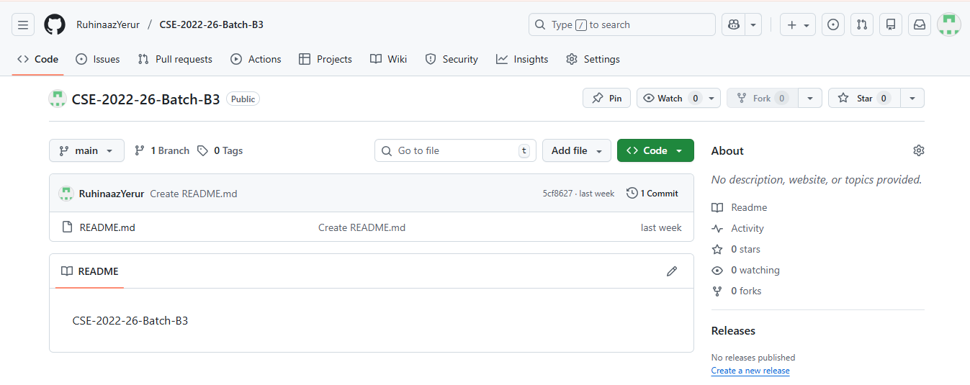
Git Hub Dashboards of each student
An Intelligent Framework for Identifing the Cooking State of Rice
Github Link: https://github.com/RuhinaazYerur/CSE-2022-26-Batch-B3
B-03 | Department of Computer Science and Engineering | Srinivasa Ramanujan Institute of Technology | 11

Slide 12
An Intelligent Framework for Identifing the Cooking State of Rice
Any Queries?
B-03 | Department of Computer Science and Engineering | Srinivasa Ramanujan Institute of Technology | 12

